Slide 1
Dungeon Organizer
By
The Gnolls
Presenter: Mike
Notes:
Russell

Slide 2
Team Members
Jacqueline Munroe - Project Lead
Michael Dunton - Scrum Master
Toyanne Bennett - Documentation
Widler Rislin - Database Programmer
Russell Stephenson - Programmer
Notes:
Russell

Slide 3
Project Description
Development of an interactive website for players of Dungeons & Dragons 3.0, that allows for:
Creation/Management of Character Sheets
Searching for spells, items, races, classes, feats, etc.
Creation of Parties Comprised of a Dungeon Master (DM) and Players
Conversation and Long-Distance Play via a Bulletin Board

Slide 4
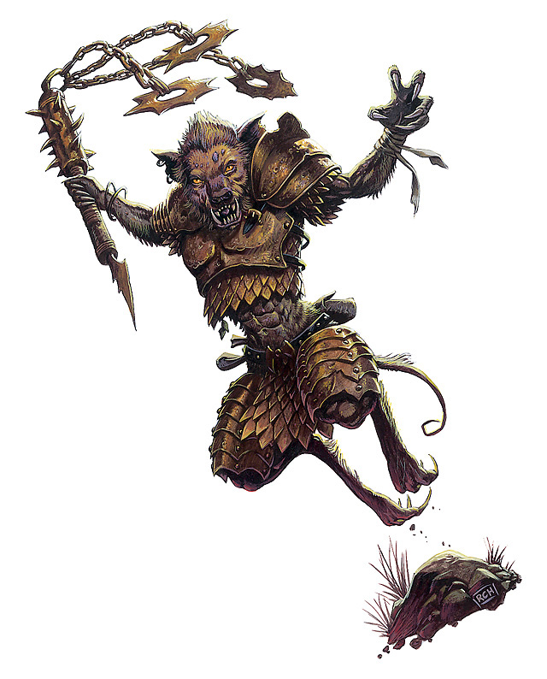
Collaboration
Github
https://github.com/gnolls/Yeenoghu

Slide 5
This Week's Accomplishments
Meeting 2/12/2013
Talked about organising database tables
Normalising the spells
Creating User Login and Profile
VirtualBox
installed Linux, apache, MySQL, PHP
Preparation for phpBB
Framework: CodeIgniter

Slide 6
Next week
Style Sheet
Main page
Login/Account Creation
PHPBB sql user tables linked with main site.

Slide 7
Expended cost to date
6 Hours
$225
Server Costs
60 Dollars a year + 9.95 for domain name.
Running Total
$294.95

Slide 8
Issues not resolved
Dungeons and dragons has a large number of spells and attributes
Normalizing data will be complicated

